Slide 1

Predicting Future Crimes using Time Series Analysis
Members: Tejas Ramesh, Saksham Nayyar, Sahil Shrikrishna Zele, Swapneel Suhas Vaidya
Faculty: Prof. Keren Zhou
Notes:
Introduction with your names and project name

Slide 2
Project Overview
Our project aims to predict future crimes in Baltimore through the application of time series analysis.
Key question: Can time series forecasting models accurately predict future crime incidents, assisting law enforcement in proactive public safety measures?
Learning different forecasting models

Slide 3
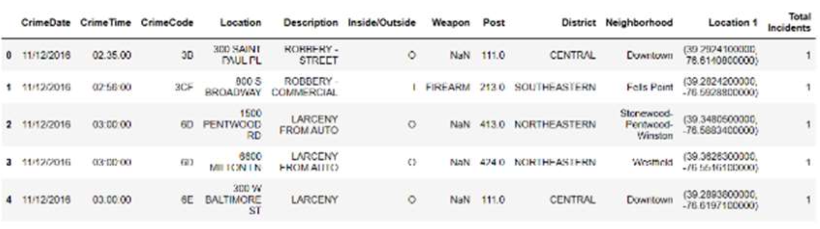
Dataset
Total 286,000 records of crimes reported between 2011 and 2016.
Each record contains spatial and temporal information.

Slide 4
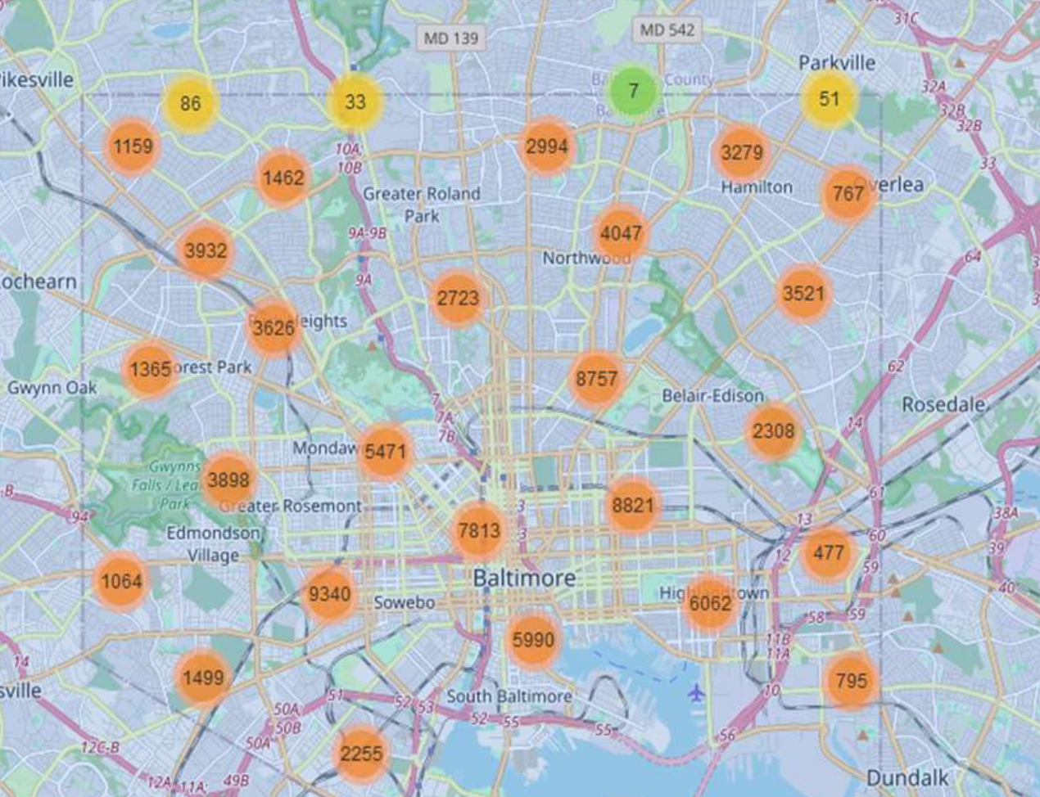
EDA
Spatial distribution of crimes.
Helps us consider other unforeseen factors such as street layout, lighting, surveillance, etc. which may influence crime

Slide 5
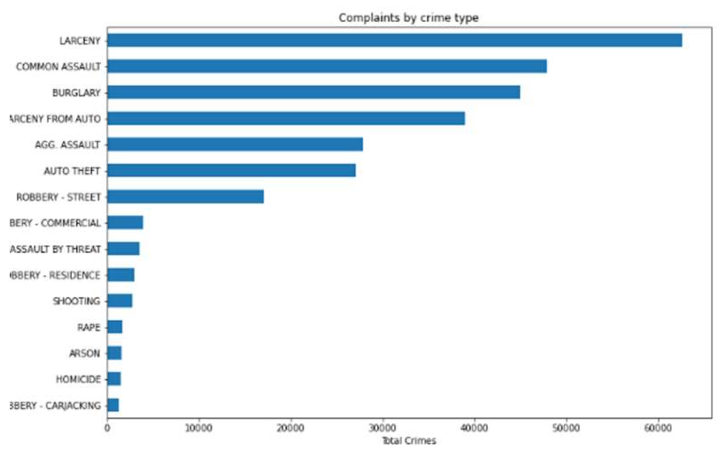
EDA
Types of crimes occurred throughout the dataset.

Slide 6
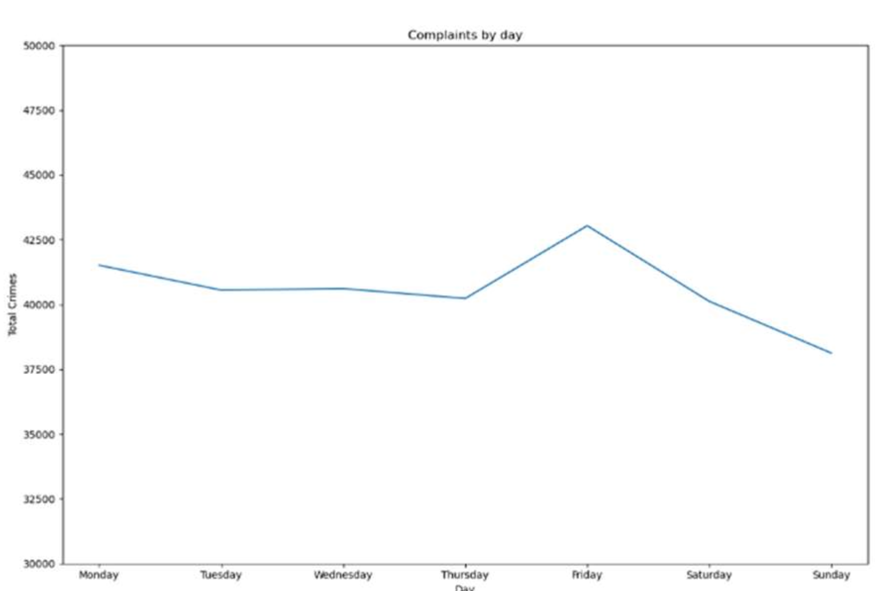
EDA
insight on the crimes on plotted by the days of a week.

Slide 7
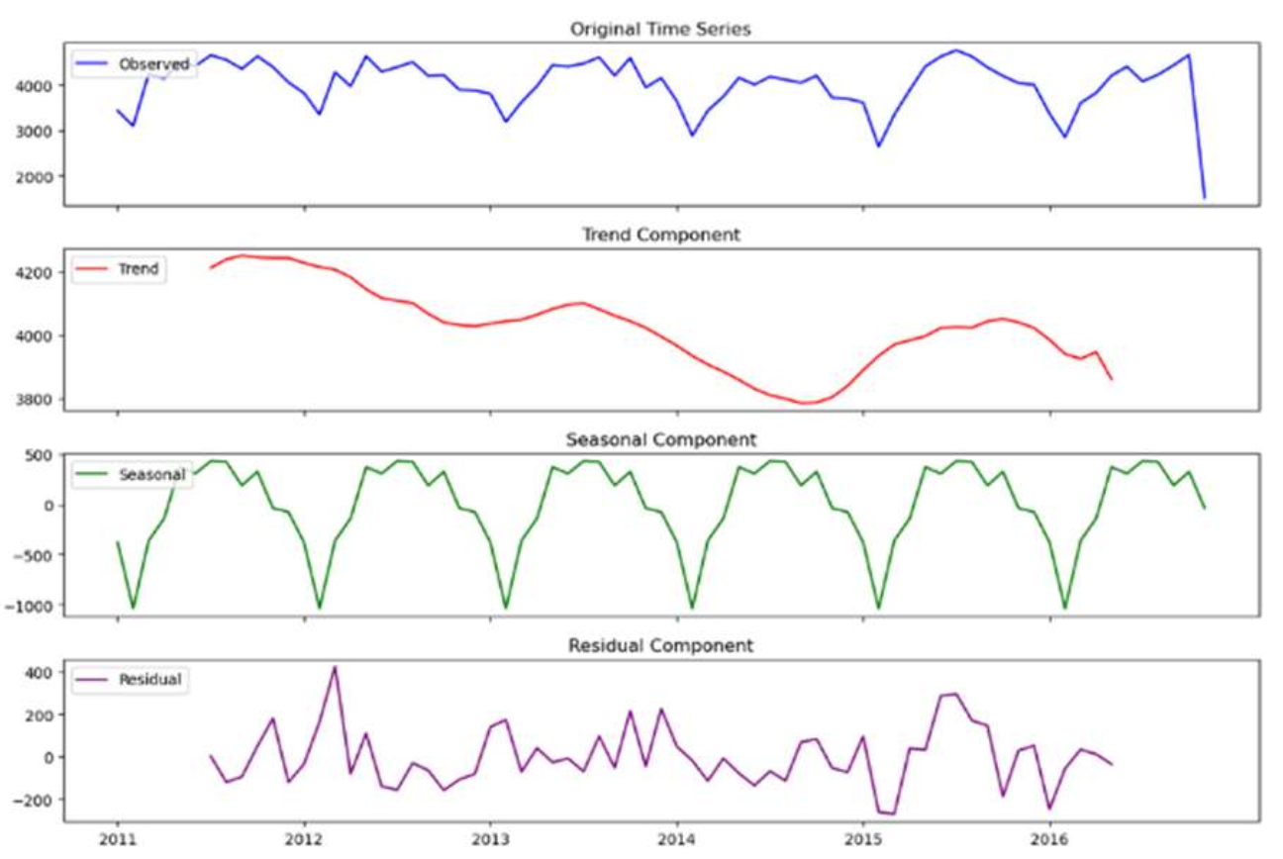
Decomposition
Observed Time series = Trend + Seasonality + Residual
Notes:
Trend represents the overall long-term movement of data, meaning it suggests the total incidents of crime
that have occurred throughout the duration of the data.
Seasonal components capture the regular and repeating patterns at fixed intervals of time. It represents systematic fluctuations in the data. In this dataset it represents how the crime incidents are affected for a short duration, and how the pattern repeated over a duration of time.
Residual components are the error remainder, it represents the random variation in the series that is not accounted in trends and seasonal components.
To get an idea of seasonality and trends in the data, we had to first get the data aligned with those features. We first split all the data representing crimes for years. To achieve this, we used the CrimeDate feature, which was initially preprocessed to get the time stamp values and created a series containing Year and total complaints made in that year.

Slide 8
Models
Linear Regression
captures linear relationship between time and crime counts.
Exponential Smoothing
Single Exponential Smoothing
Based on Exponentially weighted average of past observations
st=αxt+(1–α)st-1 =st-1 +α(xt –st-1)
Double Exponential Smoothing
Single Exponential Smoothing with trend component
st =αxt +(1–α)(st-1 +bt-1)
bt =β(st –st-1)+(1–β)bt-1
Triple Exponential Smoothing
Exponential Smoothing with trend component and seasonal pattern

Slide 9
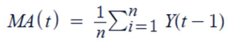
Models
Naïve Model
Next time step’s value = latest observed data point
s(t+1)=s(t)
Moving Average
n is the order of the moving average model
Y(t−i) represents the observed values in the time series.
3-Point Moving Average : n = 3
6-Point Moving Average : n = 6
9-Point Moving Average : n = 9
12-Point Moving Average : n = 12
Notes:
s(t+1) is the forecasted value for the next time step and s(t) is the most recently observed value.

Slide 10
Models
ARIMA Model
Denoted as ARIMA (p, d, q), Where:
P : Order of the autoregressive component.
d : Degree of difference
q : Order of the moving average component
SARIMA Model
Seasonal ARIMA
Denoted as. SARIMA (p, d, q)s, Where:
S : Seasonality parameter
SARIMAX Model
Includes Exogenous variables

Slide 11
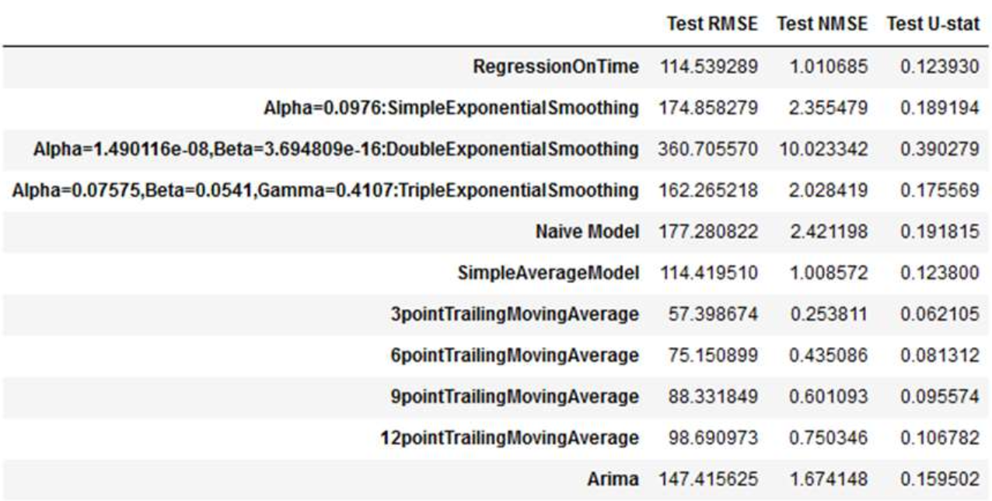
Model performance

Slide 12
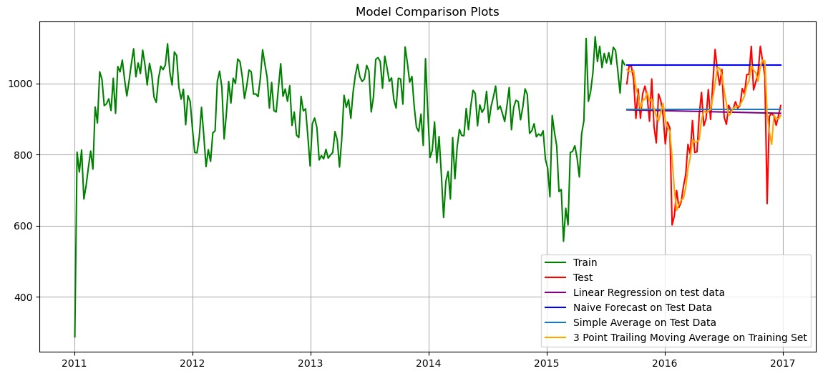
Model performance
Comparison between the test predictions between different forecasting models.

Slide 13
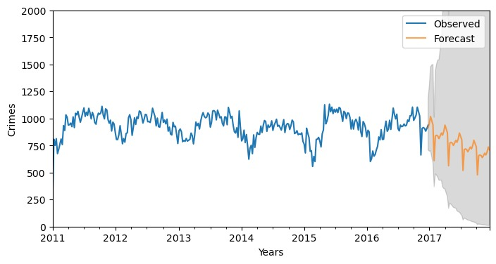
Model performance
Forecast received by SARIMAX Prediction model for the next one year.

Slide 14
Challenges and future work
Challenges
Quality of data
Visualization Feasibility
Ethical Considerations
Future Work
Improvements in EDA to further understand the data.
Implementing more sophisticated models such as Neural Networks.
Publishing possible research under more reformed and significant results.

Slide 15
Thank you!

